Slide 1
Literary Devices
Review

Slide 2
Literary Devices
Tools writers use to enhance their texts
Unlike elements, certain devices might not exist in all texts
Can be used in all genres, poetry, fiction, nonfiction and drama

Slide 3
Symbolism
SomeTHING that represents an idea
Can be universal or specific to a story
Universal symbols: colors, seasons, light, animals, etc.
https://www.youtube.com/watch?v=NG2zyeVRcbs
https://www.youtube.com/watch?v=EoCPuhhE6dw

Slide 4
Analyze the object or events in each song
How do each of the speakers feel about these objects or events?
So what do they symbolize?

Slide 5
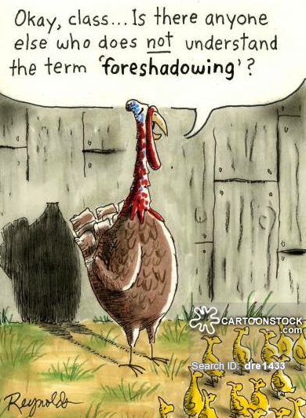
Foreshadowing
An author’s use of hints or clues to suggest events that will occur

Slide 6
Foreshadowing continued
Little Red Riding Hood:
Once upon a time, there was a little girl who lived with her mother. Her mother asked her to take her old and lonely grandmother some food one day. "Don't stop along the way. Go straight to your Grandma's house and back. Don't talk to any strangers and watch out for the wolf in the woods! Now get along !”
What does this foreshadow? And what evidence supports/proves this?

Slide 7
Flashback
An interruption in the narrative to show an episode that happened before that particular point

Slide 8
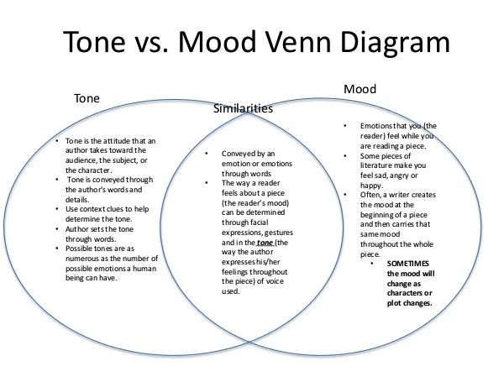
Tone and Mood

Slide 9
Allusion
A reference to a person, place or event or to another literary work
What is the allusion if someone is called a Nazi? (soup Nazi)
What is being alluded to if a place is described as an Eden?
“We’re not in Kansas anymore.”

Slide 10
Irony
Verbal: when words are used to suggest the opposite of their usual meaning
Situational: when an event occurs that is exactly opposite of expectation
Dramatic: when audience knows something of present or future circumstances that the character(s) do(es) NOT

Slide 11
Review Game
2 sides… door and window compete to name the device correctly.
Each side will send a representative up to face off against the opponent.
If you think you know the answer, buzz in!

Slide 12
Question 1
Video Clue:
https://www.youtube.com/watch?v=6y5fZifArB4

Slide 13
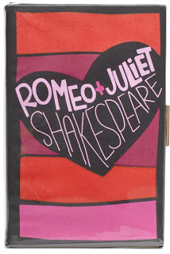
Question 2
“Go ask his name: if he be married.
My grave is like to be my wedding bed.” (from Romeo and Juliet)

Slide 14
Question 3
Phone out of service? Give us a call.

Slide 15
RID SHAMPOO
Use this mnemonic to remember the above devices to analyze poetry

Slide 16
Repetition
The chorus of a song is repeated to draw attention to the important ideas that are being discussed. Likewise, in poetry, literature and nonfiction, writers sometimes use repetition to draw attention to certain details.
https://www.poets.org/poetsorg/poem/still-i-rise
Why does Maya Angelou continue to use the phrase “I Rise” in her poem?

Slide 17
Imagery
Language that appeals to any of the 5 senses- sight, smell, sound, touch, taste
A description of a concert and its sound can be rich in imagery, even if nothing is mentioned about what it “looks like”
Likewise, a description of the aromas of your great-grandmother’s cooking wafting through your house on a summer’s evening consists of imagery- “the warming of cooked onions and oil peppered with the bite of garlic and pungent fish…the familiar char of skin, all creating the rich smell of home”

Slide 18
Diction
An author’s choice of words—does he or she use elevated language to make it seem more formal? Does he or she use slang? Are there words that are not in English? For what purpose?
http://www.poemhunter.com/poem/mother-to-son/
What does the diction tell us about the speaker of the poem?

Slide 19
Simile
Similes, metaphors and personification are examples of figurative language in which an author attempts to find similarities between dissimilar things
Similes are easy to spot because in the comparison the author uses the words “like” or “as”
The school year went by like crystallized honey flowing from a jar-- slowly, intermittently, inevitably…

Slide 20
Hyperbole
An exaggeration for effect– can show strong feelings toward something
I have a ton of pencils you can borrow. (a ton is 2,000 lbs!)
We waited forever to buy the tickets.
I haven’t eaten since breakfast… I’m starving!

Slide 21
Alliteration
the repetition of initial sounds in neighboring words.
Soothingly, silently, somberly, Anna tended to the wounded child and put her to bed.
We went wildly into the woods without looking back.

Slide 22
Metaphor
Another example of figurative language in which two unlike things are compared– this time without the use of like or as.
Metaphor states one thing IS another
“You are my sunshine, my only sunshine.”

Slide 23
Personification
Figurative language in which something nonhuman is given human attributes
The candle’s flame danced throughout the evening
The sky heaved and sobbed a terrible, torrential rain.

Slide 24
Oxymoron
a figure of speech in which apparently contradictory terms appear in conjunction
Bittersweet chocolate (bitter and sweet are opposites)
At her funeral, the parlor was filled with a deafening silence (something that is deafening is terribly LOUD, silence is the opposite)
Red Lobster is know for its lobster, cheddar biscuits and jumbo shrimp. (Jumbo means huge, shrimp means tiny)

Slide 25
Onomatopoeia
Words that sound like their meaning
Sizzle, splatter, crash, boom, hush, splash, hiss

