Slide 1
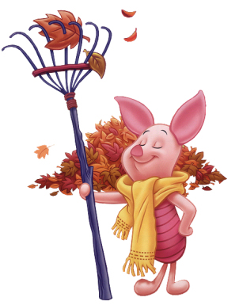
Literary Devices
Literary Elements
&
Literary Techniques

Slide 2
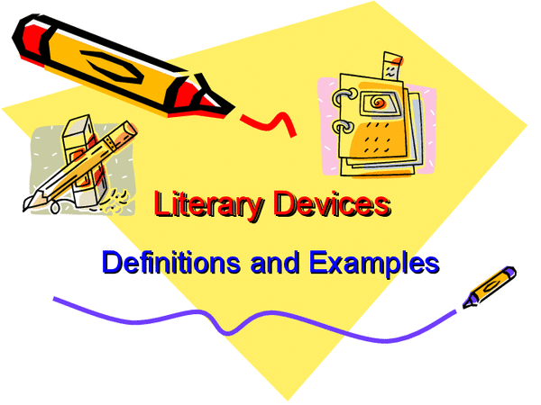
Literary devices
There are two types of literary devices: literary elements and literary techniques.
Literary elements are found in every well-written piece and are essential to the creation of the literary work.
Literary techniques are the “fancy things” authors use to strengthen their stories. They are not essential, but an authorial choice by the writer.
All devices can be used in all genres, fiction, non-fiction, poetry, and drama.

Slide 3
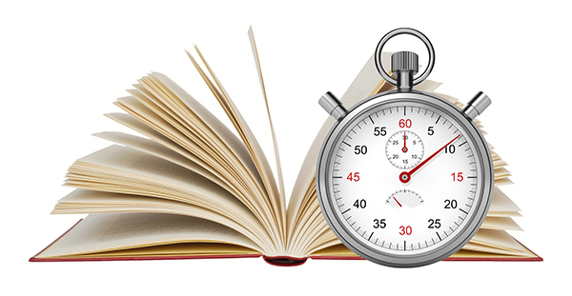
Quiz Time!
Let’s test your memory:
Write down three (3) literary elements and their definitions.
Provide examples of each literary element.
Share your definitions and examples with your partner.
Be prepared to share your definitions and examples with the class.

Slide 4
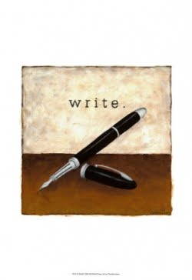
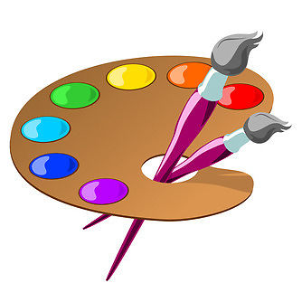
Why use literary devices?
Literary devices are “tools” used by author’s just as paints and brushes are tools used by painters.
Writers use literary devices to enhance their literary works and make their writing more interesting to the reader.

Slide 5

Literary elements
Literary elements are in every well-written story.
Let’s review some literary elements on the next slides:

Slide 6
Setting, Plot, Conflict, & theme
The setting is the time and place in which the literary work takes place.
The plot is the sequence of events in a literary work.
The conflict is essential to any good story. It’s a struggle between opposing forces (good vs. evil) and through the conflict the author will develop the theme whereby the main character or protagonist will ultimately learn, or not learn, an important lesson. This struggle can be between two characters, between a main character and society, or between two desires or impulses inside one character’s mind.
The theme is the central idea or message of the literary work, often a perception about life or human nature.

Slide 7
Plot…
the organized pattern or sequence of events that make up a story. Every plot is made up of a series of incidents that are related to one another.
4 climax or turning point
3 rising action
5 falling action
2 conflict
6 resolution
1 exposition

Slide 8
Characterization / S.T.E.A.L.
The 5 elements of characterization can be explained with the acronym S.T.E.A.L.
SPEAK = what (dialogue) and how (speaker tags & tone) a character speaks to other characters.
THOUGHTS = What a character thinks, believes, values, and what motivates a character.
EFFECTS on OTHERS = The relationships the character has with others and how characters treat each other.
ACTIONS = How a character behaves, including how they react to people and events.
LOOKS = A character’s physical appearance. This includes physical features, clothing, body language, etc.

Slide 9
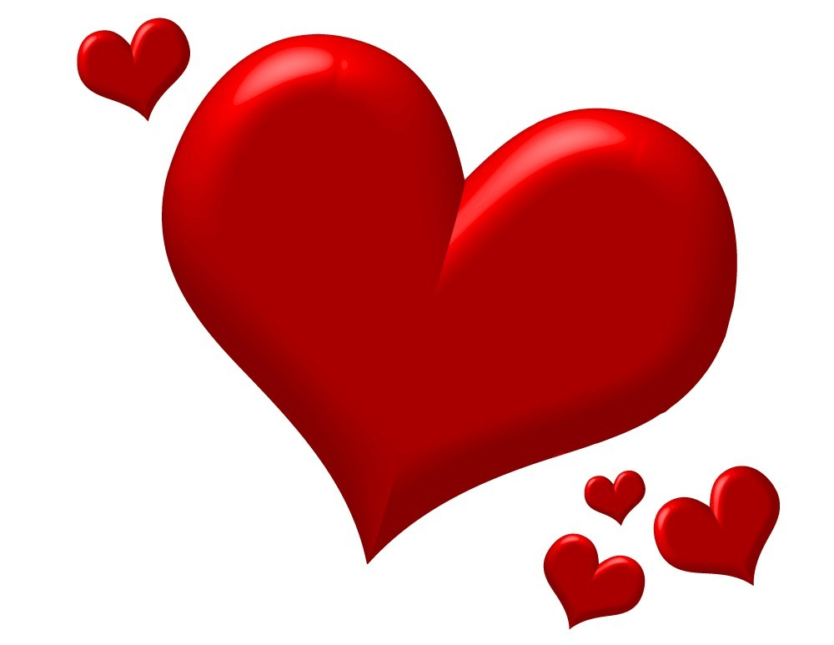

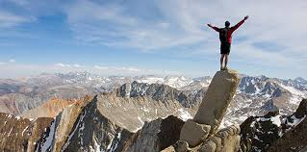
Symbolism
SomeTHING that represents an idea
Can be universal or specific to a story
Universal symbols: colors, seasons, light, animals, etc.
https://www.youtube.com/watch?v=NG2zyeVRcbs

Slide 10
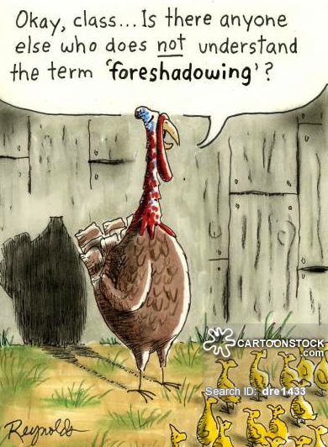
Foreshadowing
An author’s use of hints or clues to suggest events that will occur.

Slide 11
Foreshadowing continued
Little Red Riding Hood:
Once upon a time, there was a little girl who lived with her mother. Her mother asked her to take her old and lonely grandmother some food one day. "Don't stop along the way. Go straight to your Grandma's house and back. Don't talk to any strangers and watch out for the wolf in the woods! Now get along !”
What does this excerpt foreshadow? Where do readers specifically see this in the text?

Slide 12
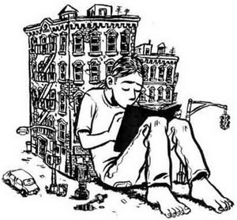
Flashback
An interruption in the narrative to show an episode that happened before that particular point.
What purpose does flashback serve for readers?

Slide 13
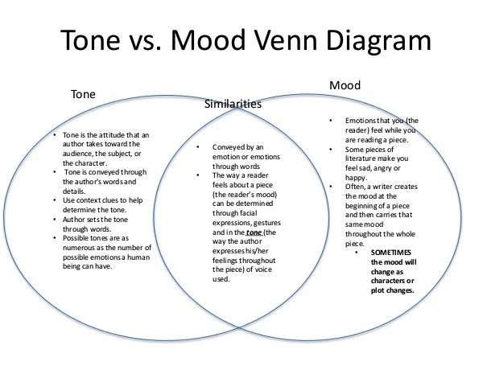
Tone and Mood

Slide 14
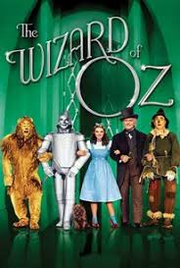
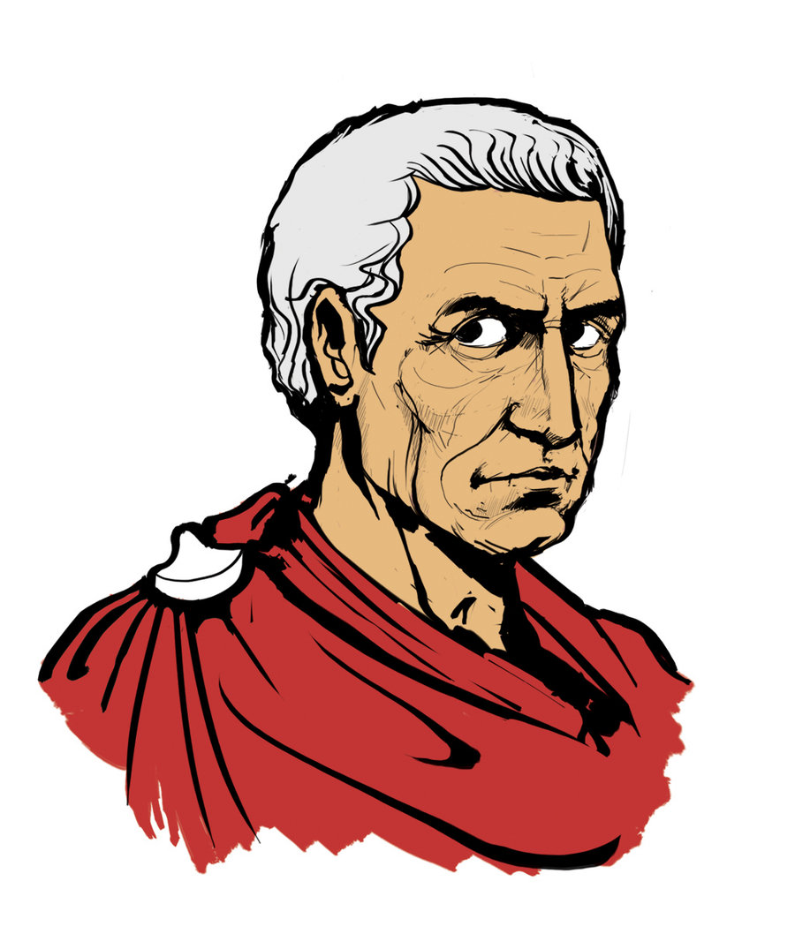
Allusion
A reference to a person, place, idea, or event of historical, cultural, literary, or political significance.
What is being alluded to if a place is described as an Eden?
What is the allusion of the phrase “We’re not in Kansas anymore.”?
In the most high and palmy state of Rome,
A little ere the mightiest Julius fell,
The graves stood tenantless and the sheeted dead
Did squeak and gibber in the Roman streets
As stars with trains of fire and dews of blood…
And even the like precurse of feared events,
As harbingers preceding still the fates
And prologue to the omen coming on…
(Hamlet Act I, sc i)

Slide 15
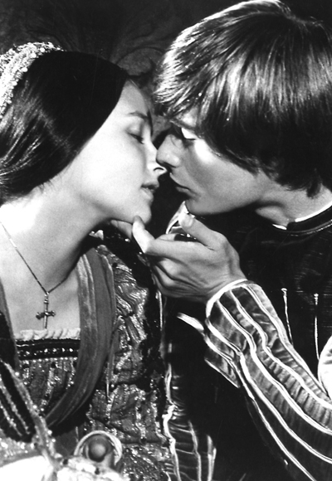
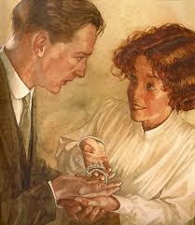
Irony
Verbal: when words are used to suggest the opposite of their usual meaning
Situational: when an event occurs that is exactly opposite of expectation (O’Henry’s “The Gift of the Magi”)
Dramatic: when audience knows something of present or future circumstances that the character(s) do(es) not (Shakespeare’s Romeo and Juliet)

Slide 16
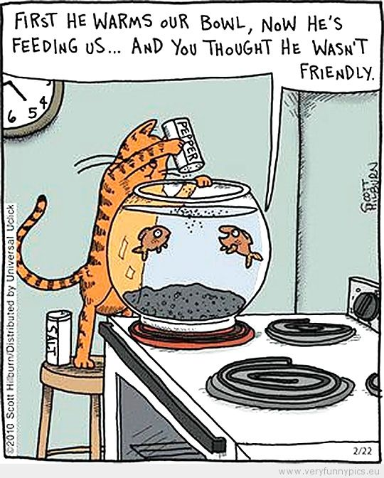
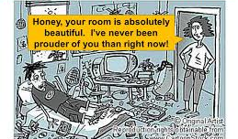
Irony
Additional examples of verbal irony:
Verbal irony occurs when words are used to suggest the opposite of their usual and intended meaning:
Thanks for the ticket officer! You really made my day.
I cannot wait to read this seven-hundred page report!
The above examples show how irony is used to show someone’s frustration or disappointment.

Slide 17
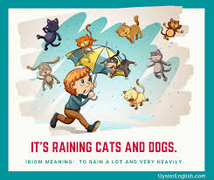
idiom
a saying, phrase, or mixed expression in a culture that has a figurative meaning different from its literal meaning. An idiom gains that meaning through repetition in a culture and is often introduced via literature, media, famous people
Examples:
It’s all Greek to me. = I don’t understand it; it’s as if it were written in the incomprehensible language of Greek.
Break a leg! = Good luck, as said to performers (it’s considered a jinx to directly wish a perform “Good luck!”)
Don’t put all your eggs in one basket. = Don’t put all your hope in one thing, as it may not work out.

Slide 18
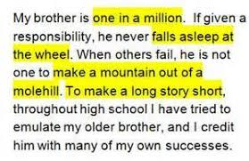
cliché
an overused or predictable expression
Examples:
As red as a rose
You can’t judge a book by its cover.
Actions speak louder than words.
Love is blind.

Slide 19

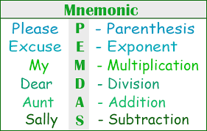
r.i.d. s.h.a.m.p.o.o.
Use the above mnemonic to remember important and often implemented literary techniques.

Slide 20
Repetition
The chorus of a song is repeated to draw attention to the important ideas that are being discussed. Likewise, in poetry, literature and nonfiction, writers sometimes use repetition to draw attention to certain details.
https://www.poets.org/poetsorg/poem/still-i-rise
Why does Maya Angelou continue to use the phrase “I Rise” in her poem?

Slide 21
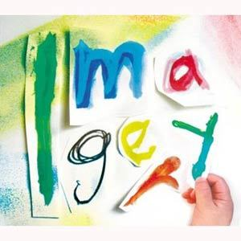
Imagery
Language that appeals to any of the 5 senses: sight, smell, sound, touch, taste
A description of a concert and its sound can be rich in imagery, even if nothing is mentioned about what it “looks like”
Likewise, a description of the aromas of your great-grandmother’s cooking wafting through your house on a summer’s evening consists of imagery- “the warming of cooked onions and oil peppered with the bite of garlic and pungent fish…the familiar char of skin, all creating the rich smell of home”

Slide 22
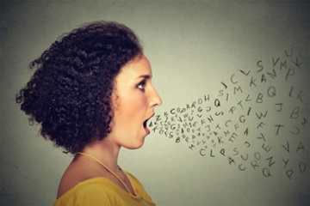
Diction
An author’s choice of words—does he or she use elevated language to make it seem more formal? Does he or she use slang? Are there words that are not in English? For what purpose?
http://www.poemhunter.com/poem/mother-to-son/
What does the diction tell us about the speaker of the poem?

Slide 23

Simile
Similes, metaphors and personification are examples of figurative language in which an author attempts to find similarities between dissimilar things
Similes are easy to spot because in the comparison the author uses the words “like” or “as”
Example:
The school year went by like crystallized honey flowing from a jar-- slowly, intermittently, inevitably…

Slide 24
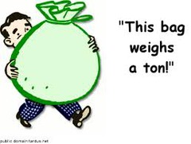
Hyperbole
An exaggeration for effect– can show strong feelings toward something
Examples:
I have a ton of pencils you can borrow. (a ton is 2,000 lbs!)
We waited forever to buy the tickets.
I haven’t eaten since breakfast… I’m starving!

Slide 25
Alliteration
the repetition of initial sounds in neighboring words.
Examples:
Soothingly, silently, somberly, Anna tended to the wounded child and put her to bed.
We went wildly into the woods without looking back.

Slide 26
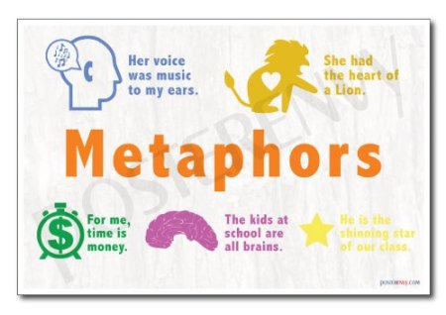
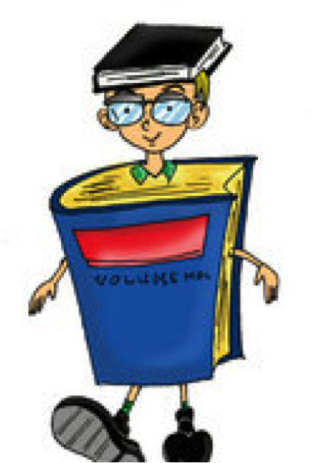
Metaphor
Another example of figurative language in which two unlike things are compared– this time without the use of like or as.
Metaphor states one thing IS another; emphasizes more strongly.
Example:
“You are my sunshine, my only sunshine.”

Slide 27
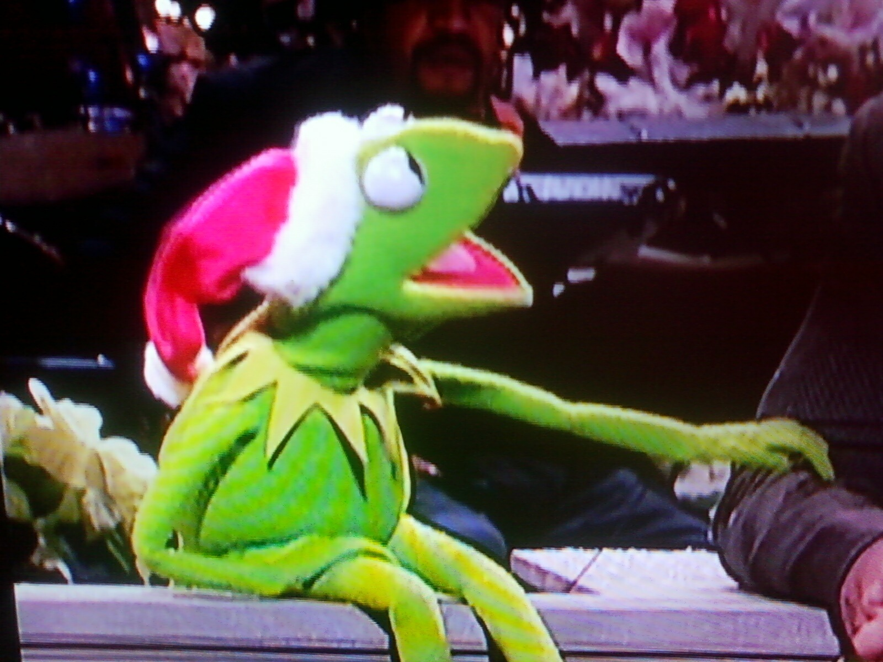
Personification
Figurative language in which something nonhuman is given human attributes
Examples:
The candle’s flame danced throughout the evening.
The sky heaved and sobbed a terrible, torrential rain.

Slide 28
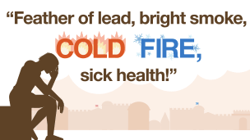
Oxymoron
a figure of speech in which apparently contradictory terms appear in conjunction
Examples:
Bittersweet chocolate (bitter and sweet are opposites)
At her funeral, the parlor was filled with a deafening silence (something that is deafening is terribly LOUD, silence is the opposite)
Red Lobster is know for its lobster, cheddar biscuits and jumbo shrimp. (jumbo means huge, shrimp means tiny)

Slide 29
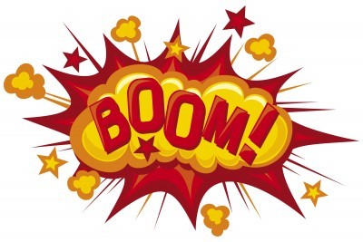
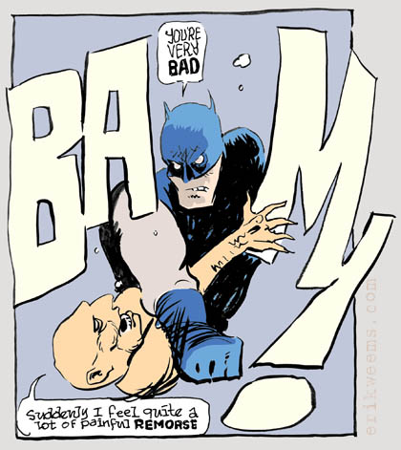
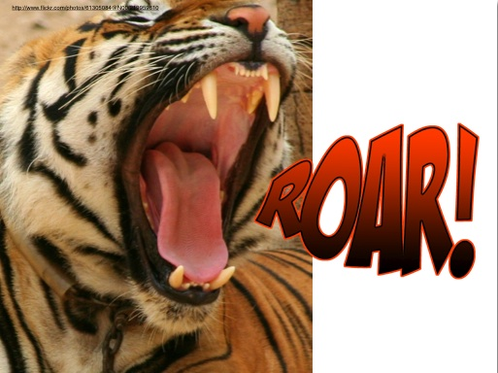
Onomatopoeia
Words that sound like their meaning
Examples:
Sizzle, splatter, crash, boom, hush, splash, hiss

Slide 30
Review game/Exit slip
After each clue, jot down answer on exit slip. Do the best you can.
Good luck!

Slide 31
Question 1
Video Clue
https://www.youtube.com/watch?v=h8nHl-2VRvg

Slide 32
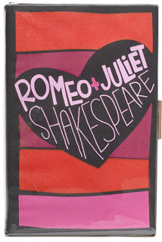
Question 2
"The gray-eyed morn smiles on the
frowning night,/Check'ring the eastern
clouds with streaks of light."
(Friar Laurence from Romeo and Juliet)

Slide 33
Question 3
Phone service out of order? Give us a call.

