Slide 1
English 12 Research Paper
Introduction & THESIS STATEMENT

Slide 2
PMhs virtual reference collection (vrc)
To navigate to the VRC
Go to PMHS Homepage – Departments – Library Media Center – Virtual Reference Collection (VRC) –
Choose Patchogue Medford High School
User Name *& Password = pmhs
Pro/Con Database: Opposing Viewpoints (general info) / Encyclopedia WWII

Slide 3
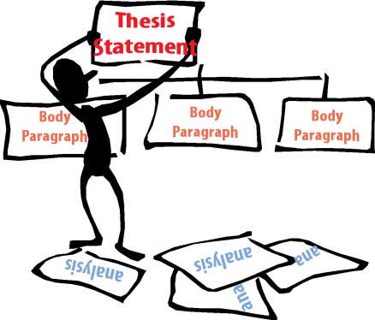
Thesis Statement
Writing a strong thesis statement is probably the most important task in completing a research paper.
Everything in your research paper should stem from and refer back to the thesis statement; it is the paper’s anchor.

Slide 4
A thesis statement
should be specific—it should cover only what you will discuss in your paper and should be supported with specific evidence.
is a single sentence at the end of your first paragraph that presents your argument to the reader.
is a way to organize your thoughts so that the rest of your paper gathers and organizes evidence that will persuade your reader of the logic of your argument.

Slide 5
Well-written thesis statement
A well-written thesis statement implies a general question about your chosen topic.
Your research paper, specifically the body paragraphs, will then provide the answers to this thesis question.
Your topic may change as you write, so you may need to revise your thesis statement to reflect exactly what you have discussed in the paper.

Slide 6
Thesis statement example
Children enjoy professional wrestling for many reasons.
This statement implies a "why?" question: Why do children enjoy professional wrestling?
Possible Thesis Statement: Although children enjoy many types of sporting events, research indicates young people are more entertained by professional wrestling because it provides excitement, social interaction, and an escape from life’s everyday challenges.

Slide 7
Thesis statement example
Students heading to college will succeed at writing research papers if they follow a clear research writing process.
This statement implies a "how?" question: How does this process or sequence proceed?
Possible Thesis Statement: Although Carota’s students might be overwhelmed at the thought of writing a research paper, they will succeed if they gather valid and informative resources, create a strong thesis statement, and compose an organized outline.

Slide 8
Thesis statement example
People consider vocational education more immediately beneficial than liberal education.
This statement implies a "what?" question: In what ways is liberal education more beneficial than vocational education?
Possible Thesis Statement: Although many people consider vocational education more immediately beneficial, liberal education offers long-term benefits to learners by teaching them to apply, analyze, and evaluate information.

Slide 9
Thesis statement example
The life of the typical college student is characterized by time spent studying, attending class, and socializing with peers.
The paper that follows should:
Explain how students spend their time studying, attending class, and socializing with peers

Slide 10
Thesis statement example
High school graduates should be required to take a year off to pursue community service projects before entering college in order to increase their maturity and global awareness.
The paper that follows should:
Present an argument and give evidence to support the claim that students should pursue community projects before entering college

Slide 11
Thesis statement example
An analysis of the college admission process reveals one challenge facing counselors: accepting students with high test scores or students with strong extracurricular backgrounds.
The paper that follows should:
Explain the analysis of the college admission process
Explain the challenge facing admissions counselors

Slide 12
Question ideas for thesis statements
What are most leading causes for people to consider suicide?
Are men more successful in committing suicide than women? Why?
What are most prominent causes for people to become clinically depressed?
Do people who suffer from clinical depression always commit suicide?
What are the circumstances that bring about profiteering?
How do ones’ family values affect development?

Slide 13
paraphrasing
Paraphrasing is using your own words to tell the reader what another author said while giving that author credit. It is important to remember that paraphrased information still requires citations.
Without the proper in-text citation and Works Cited reference, YOU ARE PLAGIARIZING! ☹
Notes:
Show Paraphrasing Properly (Word Doc)

